Slide 1


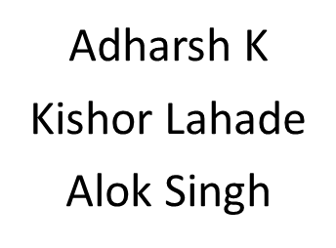
Digital News Platform

Slide 2
Problem Statement:
We are designing a digital news platform which is divided into several categories. The user will be able to log in and like and comment the post.
The admin can see the users list and view the most liked and commented post and admin can also delete the comments.

Slide 3
Approach:
1) Preparation of database design
2) Knowing the constraints what to use and linking the tables.
3) Preparing the Backend API’s for data transfer.
4) Checking of API’s with Postman.
5) Linking the UI design with backend.

Slide 4
Technologies Used:
1. MySQL (for database)
2. Spring Boot ( for backend)
3. Angular (for UI)

Slide 5
Learnings:
1) Communication among team-members.
2) Dividing the work into small tasks.
3) Implementing the technical concepts learnt during the boot camp.
4) We learnt how the news websites work.

Slide 6
Challenges:
1) Creating the column of the table to maintain the data transfer easy.
2) Connecting Frontend with Backend.
3) Implementing the UI in the angular.

Slide 7
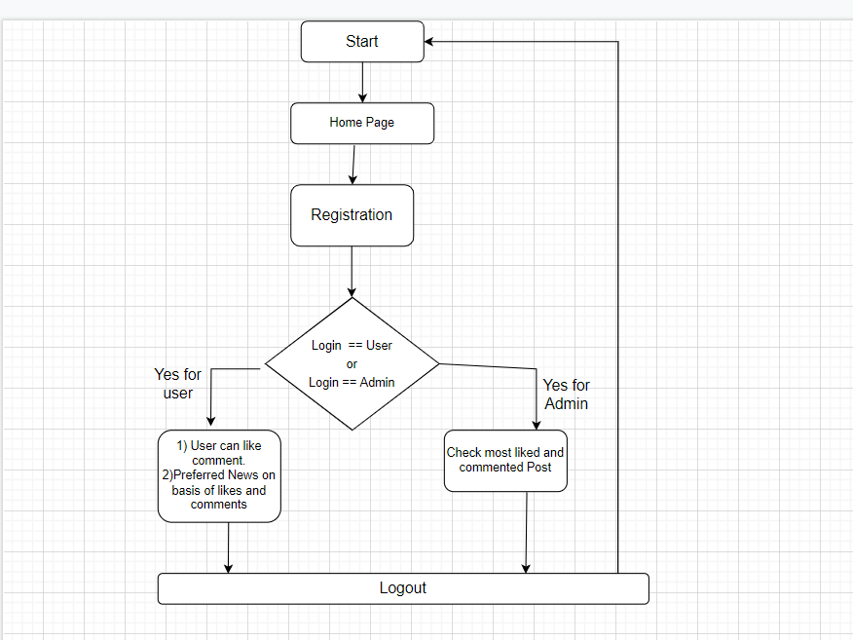
Flow Chart:

Slide 8
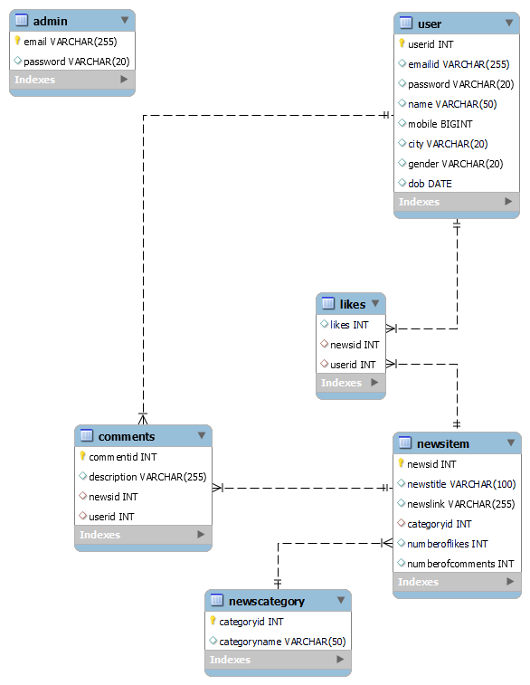
E-R Diagram:

Slide 9
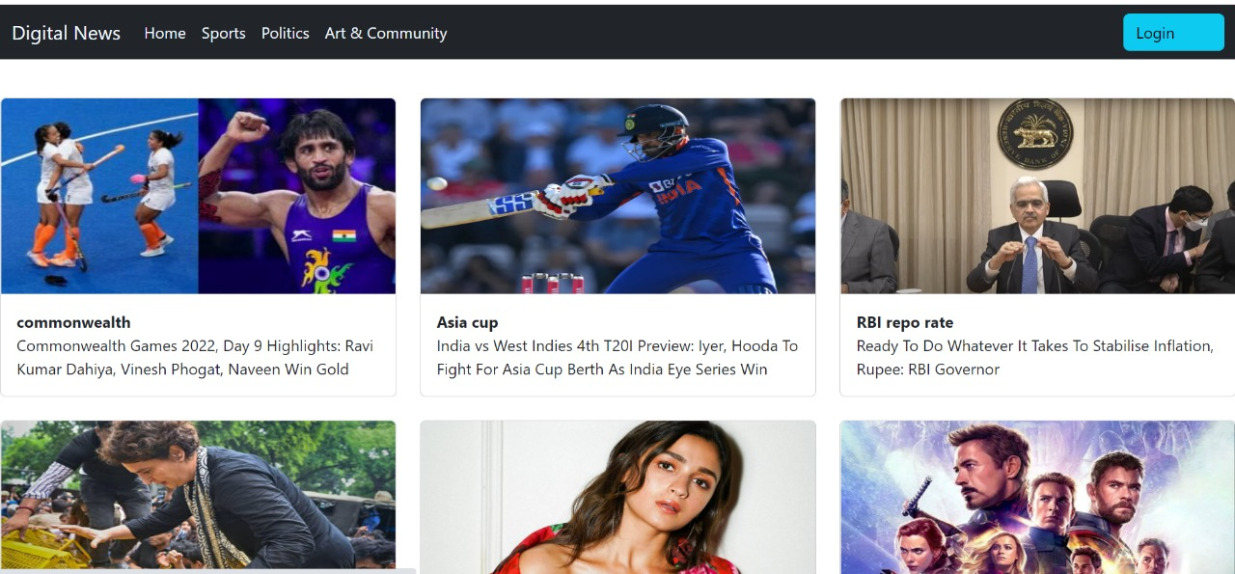
Homepage:

Slide 10
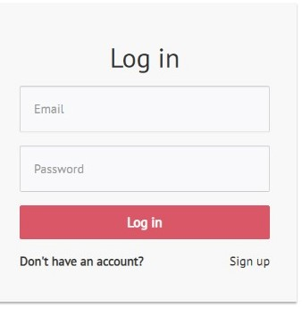
Screenshots:

Slide 11
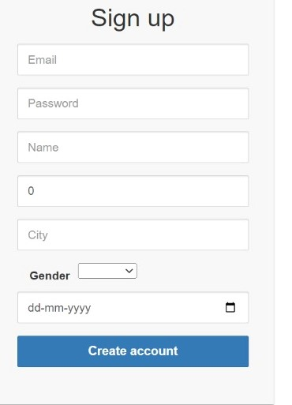

Slide 12
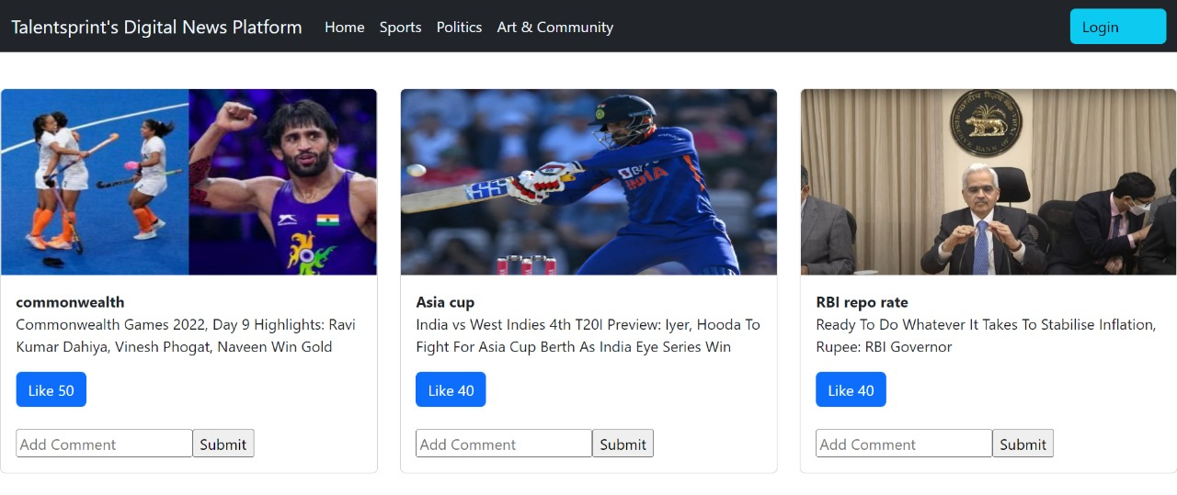

Slide 13
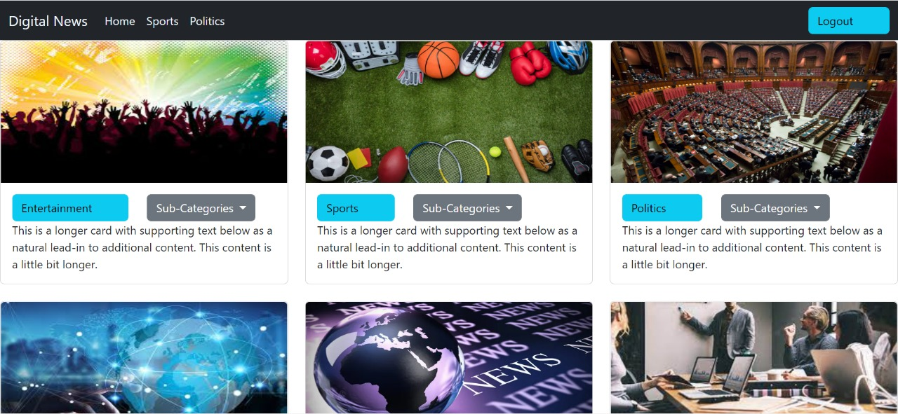

Slide 14
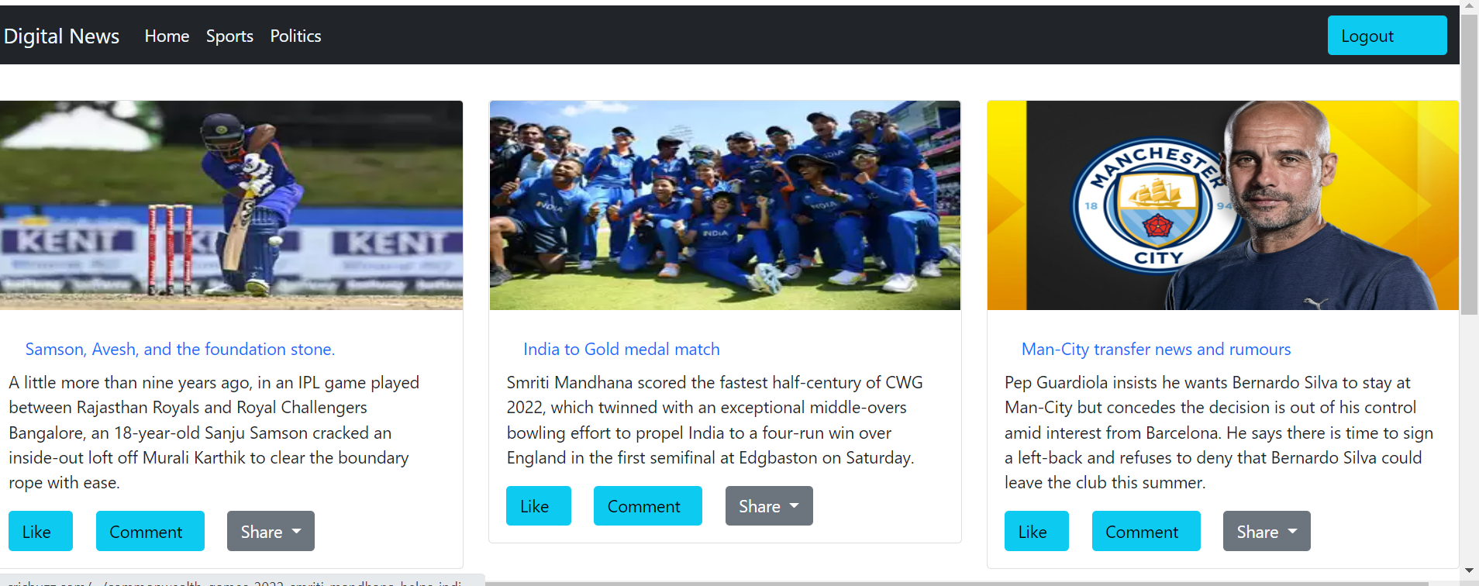

Slide 15
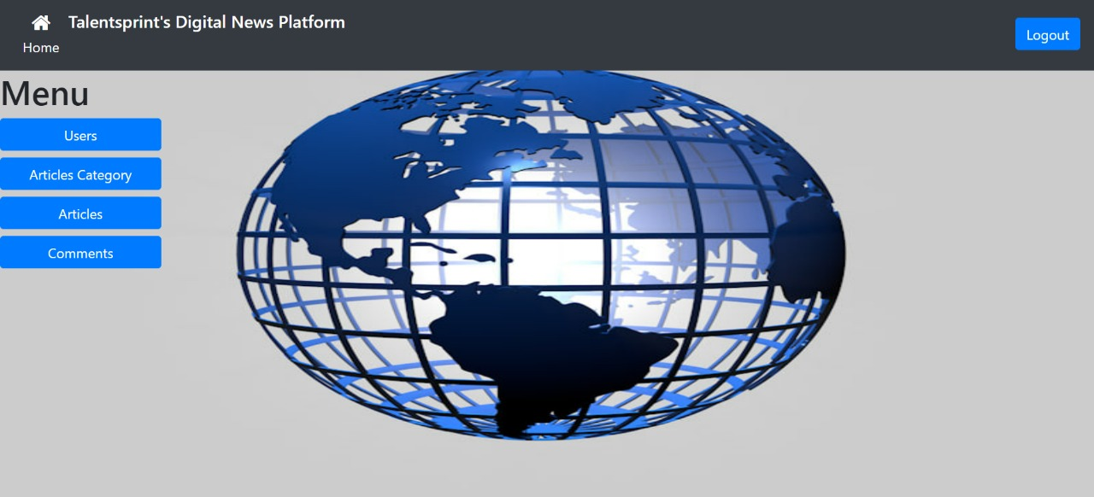

Slide 16
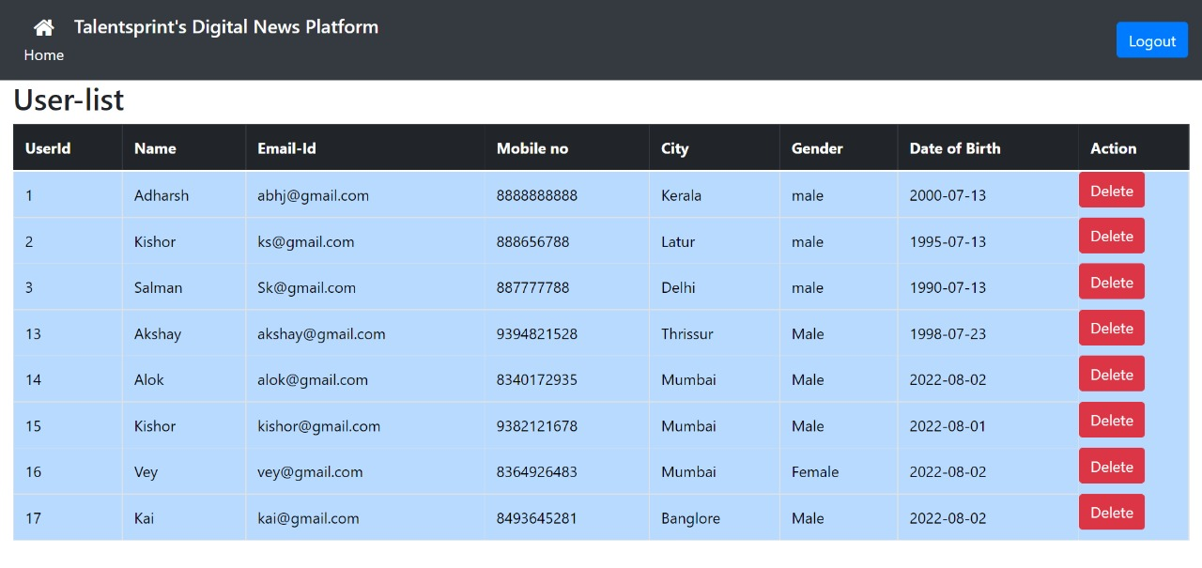

Slide 17
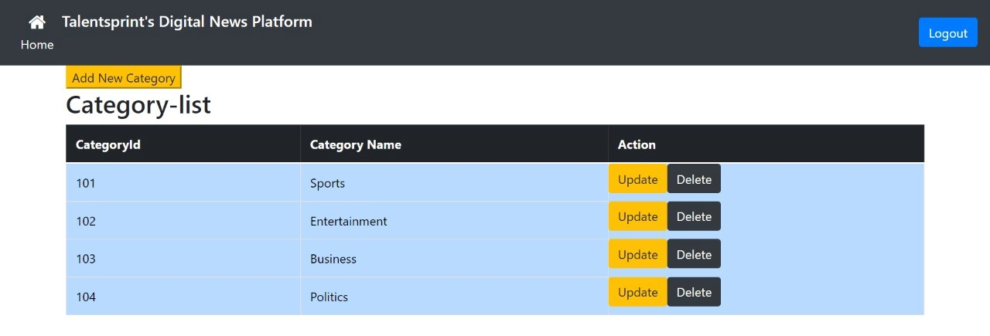

Slide 18
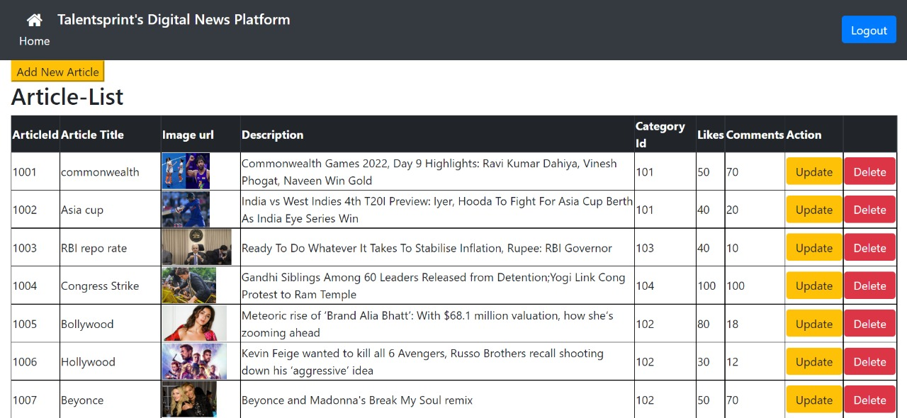

Slide 19
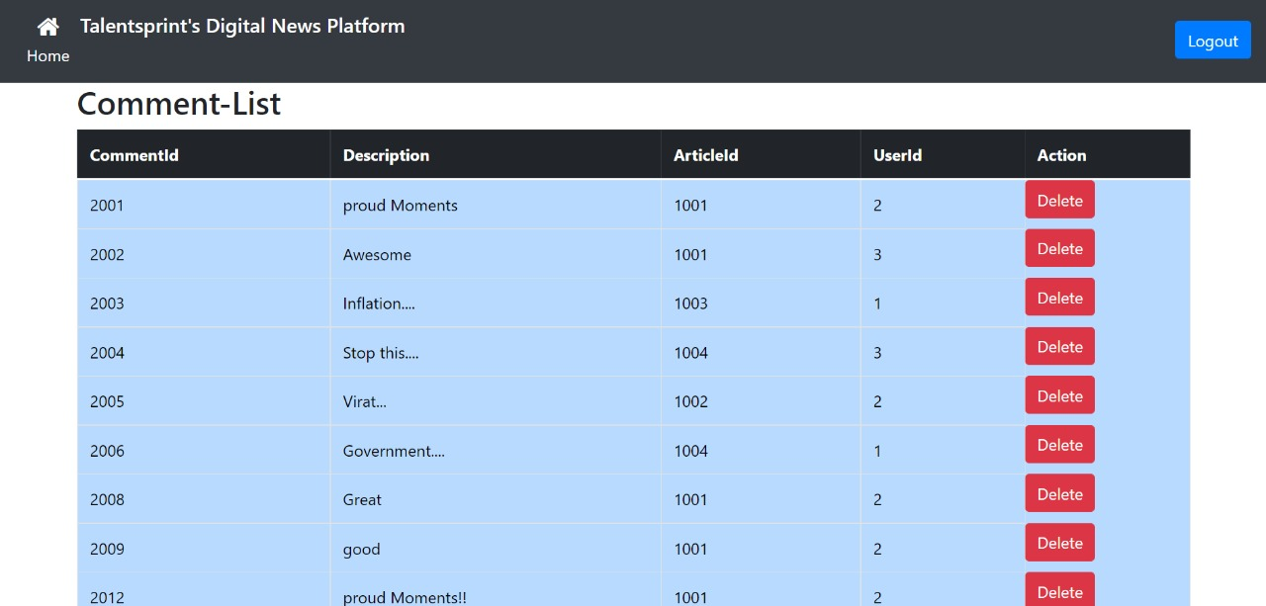

Slide 20
THANK YOU

